Slide 1
Fundamental Network Programming
RESTful API communication C#
Spring 2023

Slide 2
Agenda
What is RESTful API
HTTP, JSON
RESTful API client request
RESTful API server response
Download JSON data from a RESTful API with C#

Slide 3

What is an API (Application Program Interface)?
API
data request
Database
http request
http response
requested data

Slide 4
REST (Representational State Transfer)?
Uniform interface
Client-server based
Statelessness
Layered system
Cacheability
Code on demand

Slide 5
What is RESTful API?
GET/POST/PUT/DELETE
http request
API
data request
Database
http response
JSON/XML
requested data

Slide 6
HTTP
Method
Request
Response
Status code
GET/POST/PUT/DELETE
http request
API
http response
JSON/XML
Status code

Slide 7
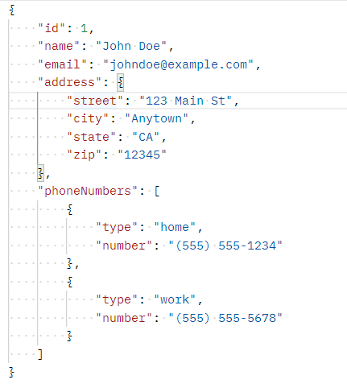
JSON (JavaScript Object Notation)
JSON object:
"employee":{"name":"John", "age":30, "city":"New York"}
JSON array:
"employees":["John", "Anna", "Peter"]

Slide 8
RESTful API HTTP Request
URI
Method
HTTP version
Request Header
Request Body

Slide 9
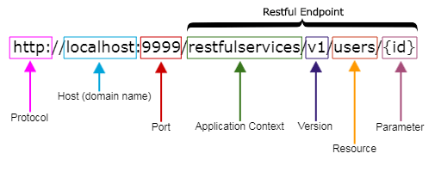
RESTful API client request
URI:
Method:
Method | Description
GET | Get information about a resource
POST | Create a resource on the server
PUT | Update existing resources on the server
DELETE | Remove the resource

Slide 10
RESTful API server response
Status code:
Message body: JSON/XML
Headers
200 OK | The request was successfully completed. A 200 status is returned for a successful GET or POST method.
400 Bad Request | The request could not be processed because it contains missing or invalid information, such as a validation error on an input field, a missing required value, and so on.
401 Unauthorized | The request is not authorized. The authentication credentials included with this request are missing or invalid.
503 Service Unavailable | The server is unable to handle the request due to temporary overloading or maintenance of the server.

Slide 11
How to call a RESTful API with C#
private async void GetTasksAsync()
{
HttpClient client = new HttpClient();
HttpResponseMessage response = await client.GetAsync("https://jsonplaceholder.typicode.com/todos/1");
if (response.IsSuccessStatusCode)
{
TodoTask task = await response.Content.ReadAsAsync<TodoTask>();
DisplayTodoList(task);
}
}

Slide 12
References
https://learn.microsoft.com/en-us/aspnet/web-api/overview/advanced/calling-a-web-api-from-a-net-client

Slide 13
Assignment week #6
Write a client application that can call an available API for get all to do list using asynchronous programming. The application should display all tasks.
Using testing api: https://jsonplaceholder.typicode.com/todos
Try with another api.

